Slide 1
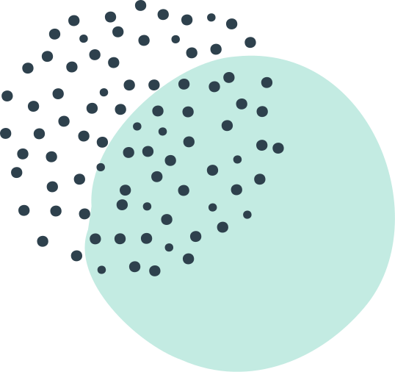
IYKRA DATA FELLOWSHIP
STATISTICS
Presentation by Muhamad Irfan Fadhullah

Slide 2

Outline
Statistics
Probability
Descriptive Statistics
Inference Statistics
Statistical Learning

Slide 3
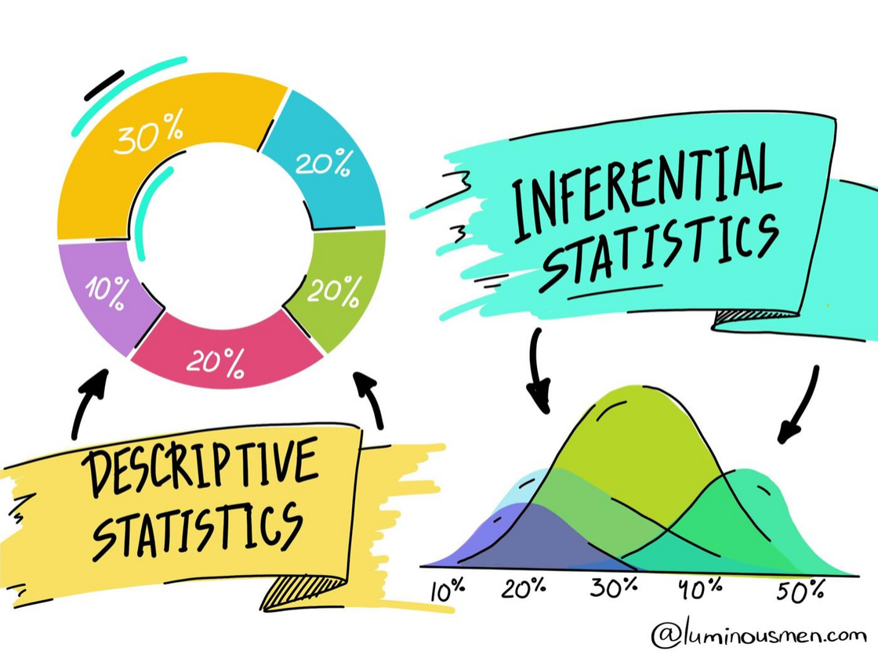

What is Statistics?
Statistics is a mathematical body of science that pertains to the collection, analysis, interpretation or explanation,and presentation of data.
There are two type of Statistics,
Descriptive Statistics
Inferential Statistics

Slide 4
TYPE OF VARIABLE
NUMERICAL
CATEGORICAL
CONTINOUS
DISCRETE
ORDINAL
CATEGORICAL
Height
Temperature
No. of house
No. of cars
Education Level
Horse Power Level
Gender
True/ False

Slide 5
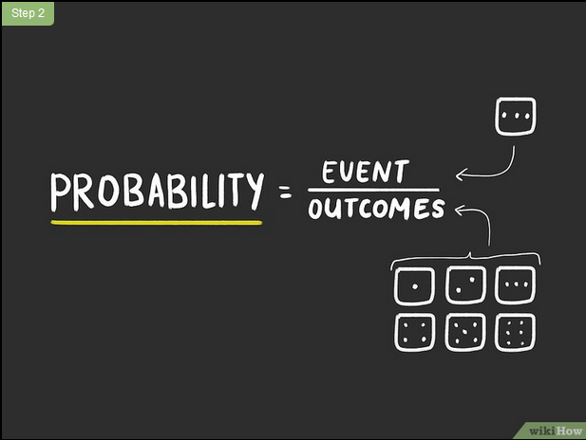
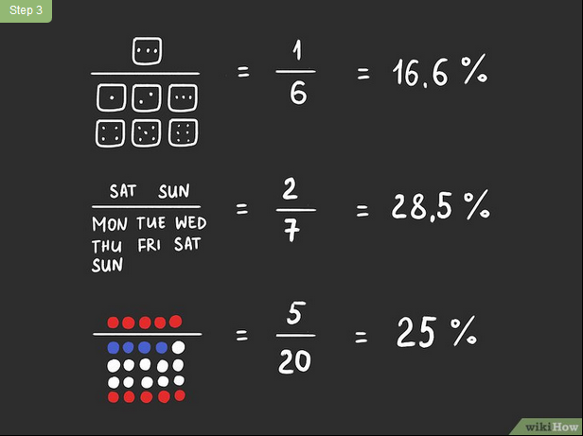
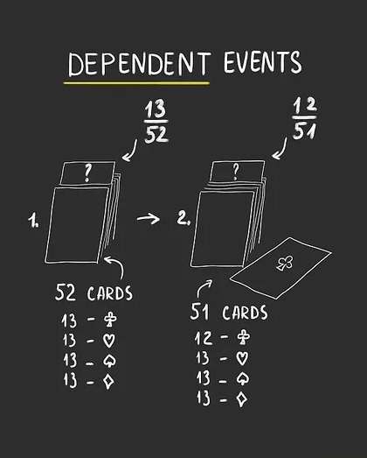
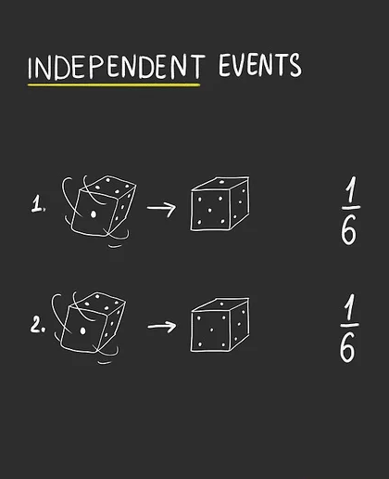
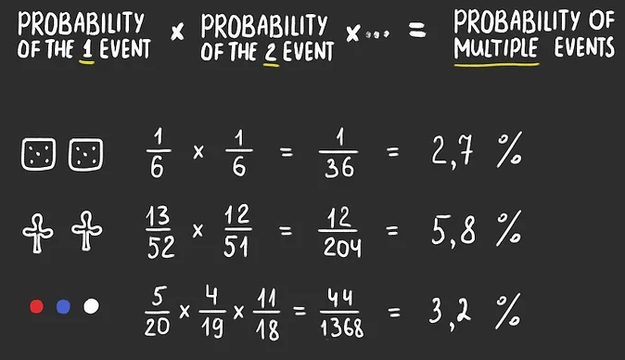
PROBABILITY

Slide 6
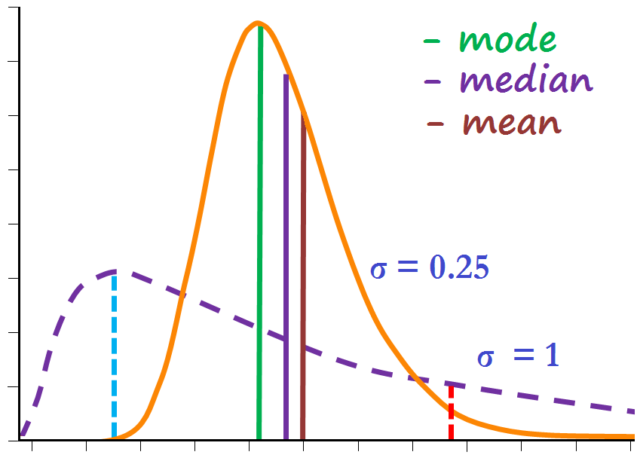
Descriptive Statistics
Descriptive Statistics is a summary statistic that quantitativelydescribes or summarizes features of a collection of information and they not involve generalizing beyond the data at hand.

Slide 7
INSIDE DESCRIPTIVE STATISTICS
Measure of Central Tendency
Measure of Spred/ Dispersion
Skewness
Correlation
Kurtois

Slide 8
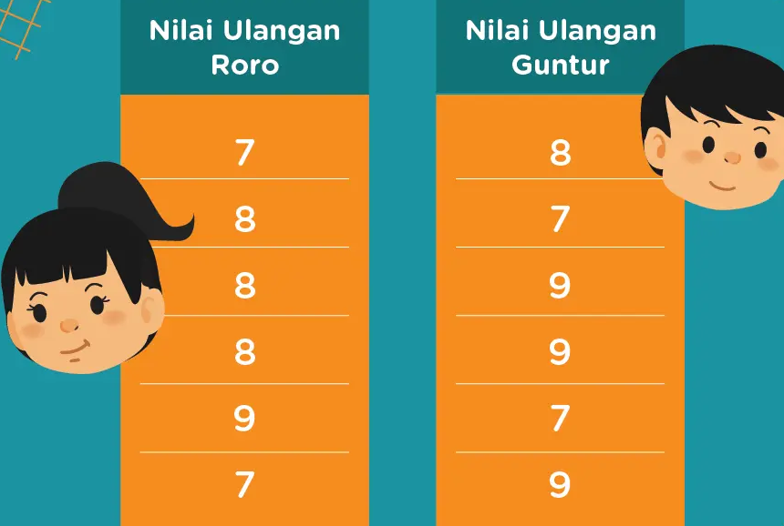
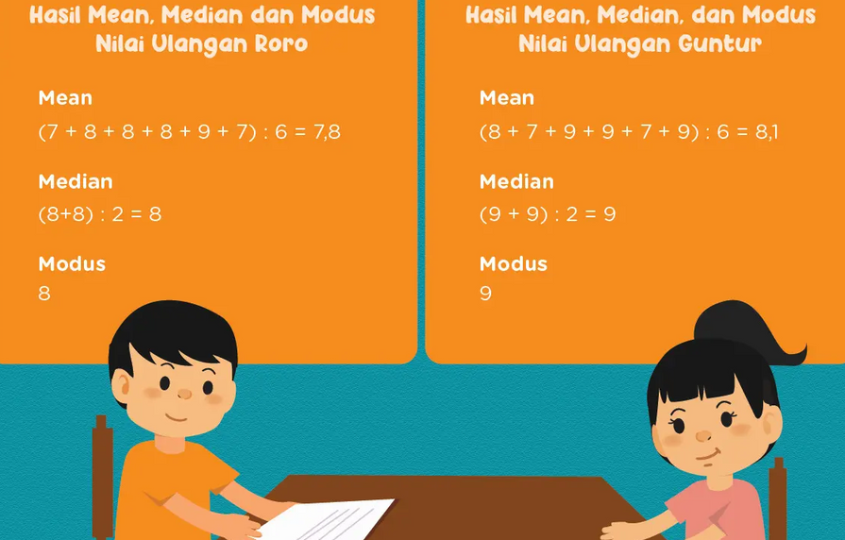
Mean
Median
The average of the numbers
Median is the middle value of the numbers, but we must sorting it first
Mode
The mode is the number that is repeated more often than any other
MEASURE OF CENTRAL TENDENCY

Slide 9
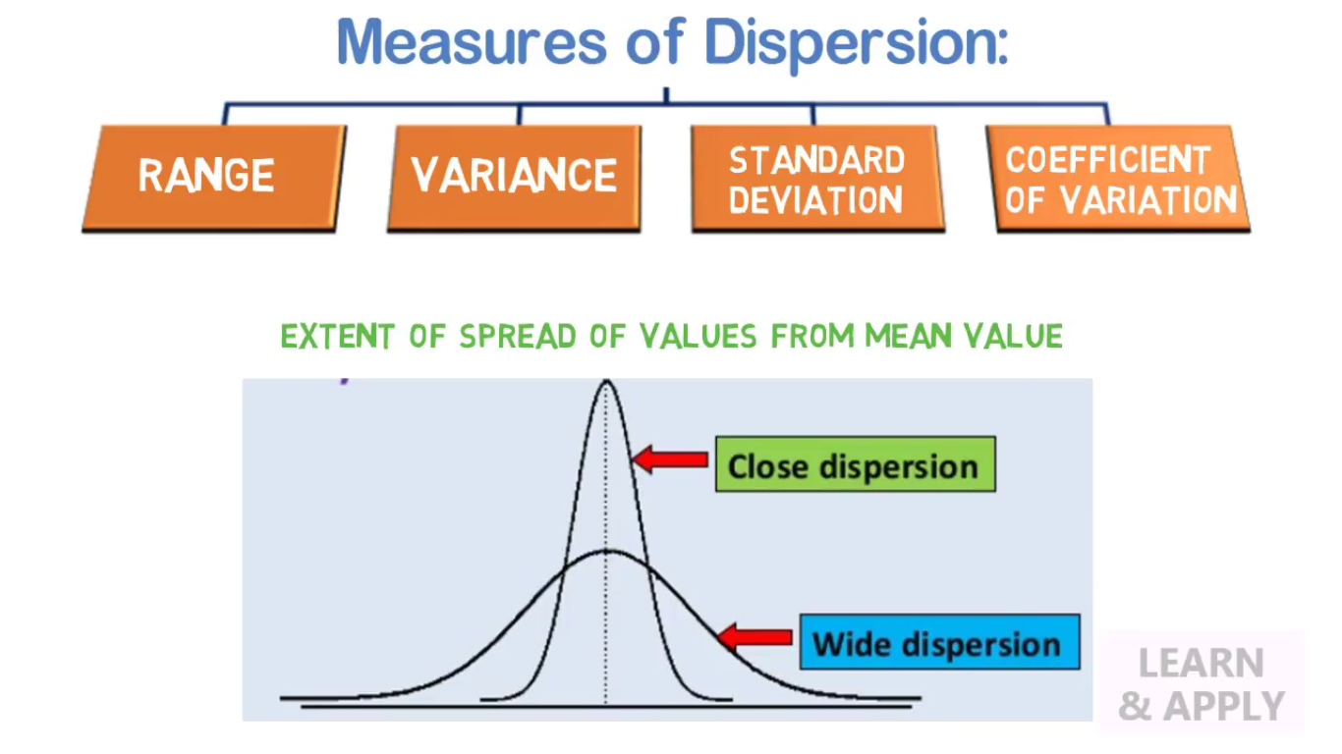
Standard Deviation
Range
Variance
Quartile
MEASURE OF SPREAD/ DISPERSION

Slide 10
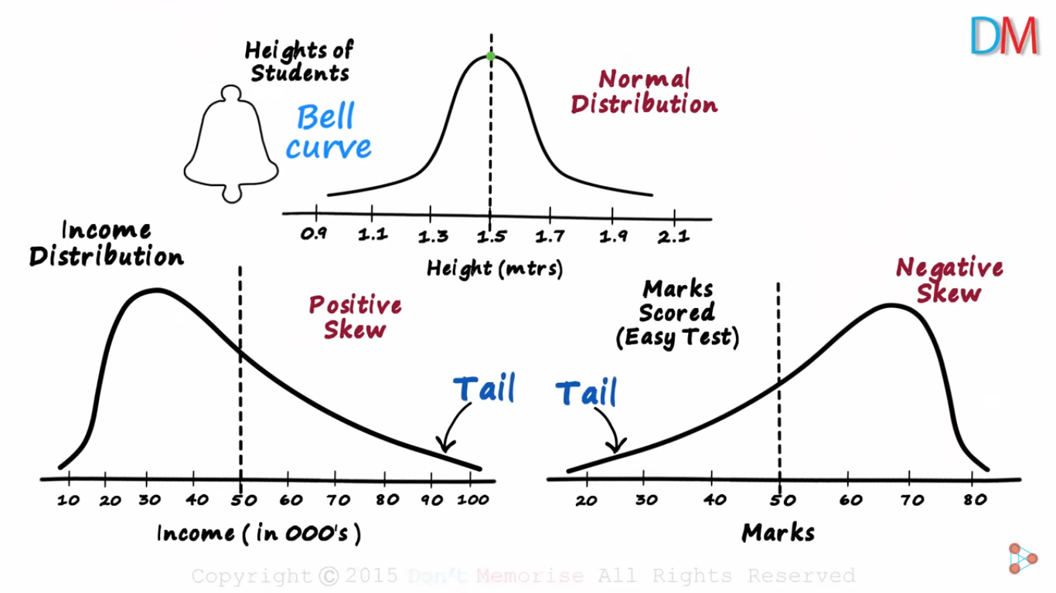
SKEWNESS

Slide 11
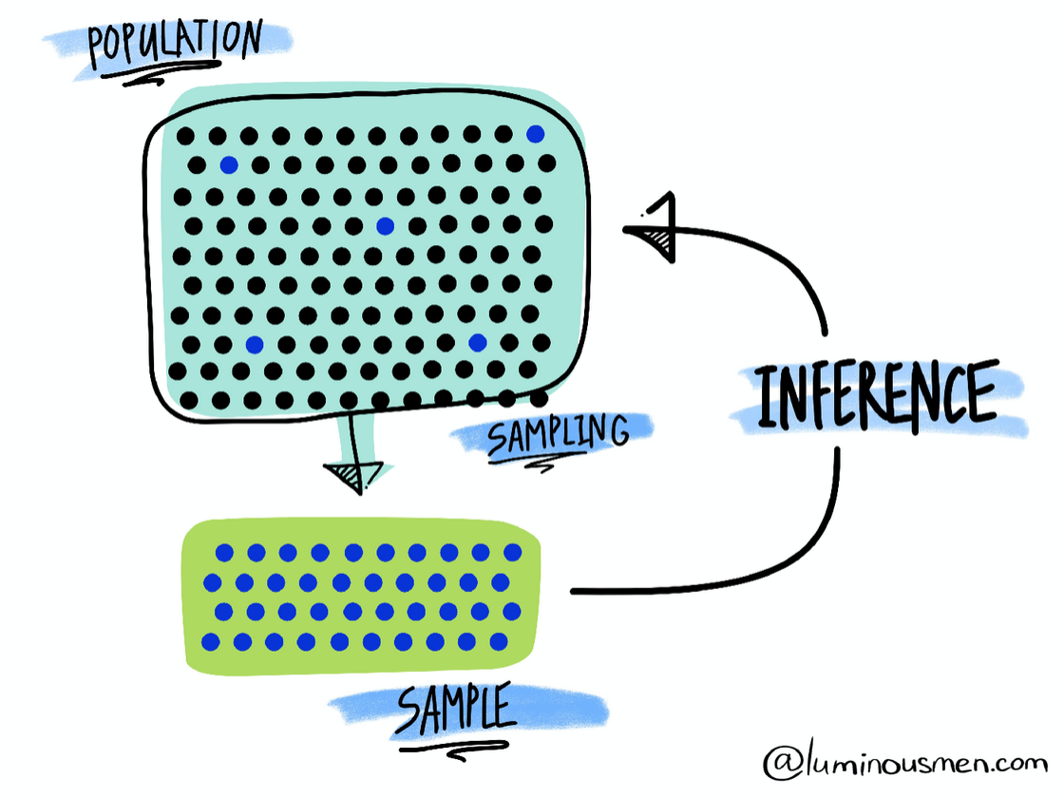
Inferential Statistics
Inferential statistics allows you to make inferences the population from the sample data.

Slide 12
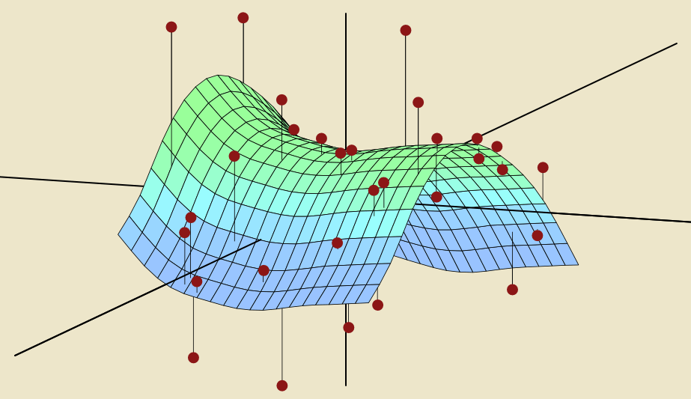
Statistcal Learning
Statistical learning theory is a framework for machine learning drawing from the fields of statistics and functional analysis.
Machine learning is a manifestation of statistical learning techniques implemented through software applications.

Slide 13
EXPLANATION
Supervised
Supervised statistical learning involves building a statistical modelfor predicting, or estimating, an output based on one or moreinputs
Regression
Classification

Slide 14
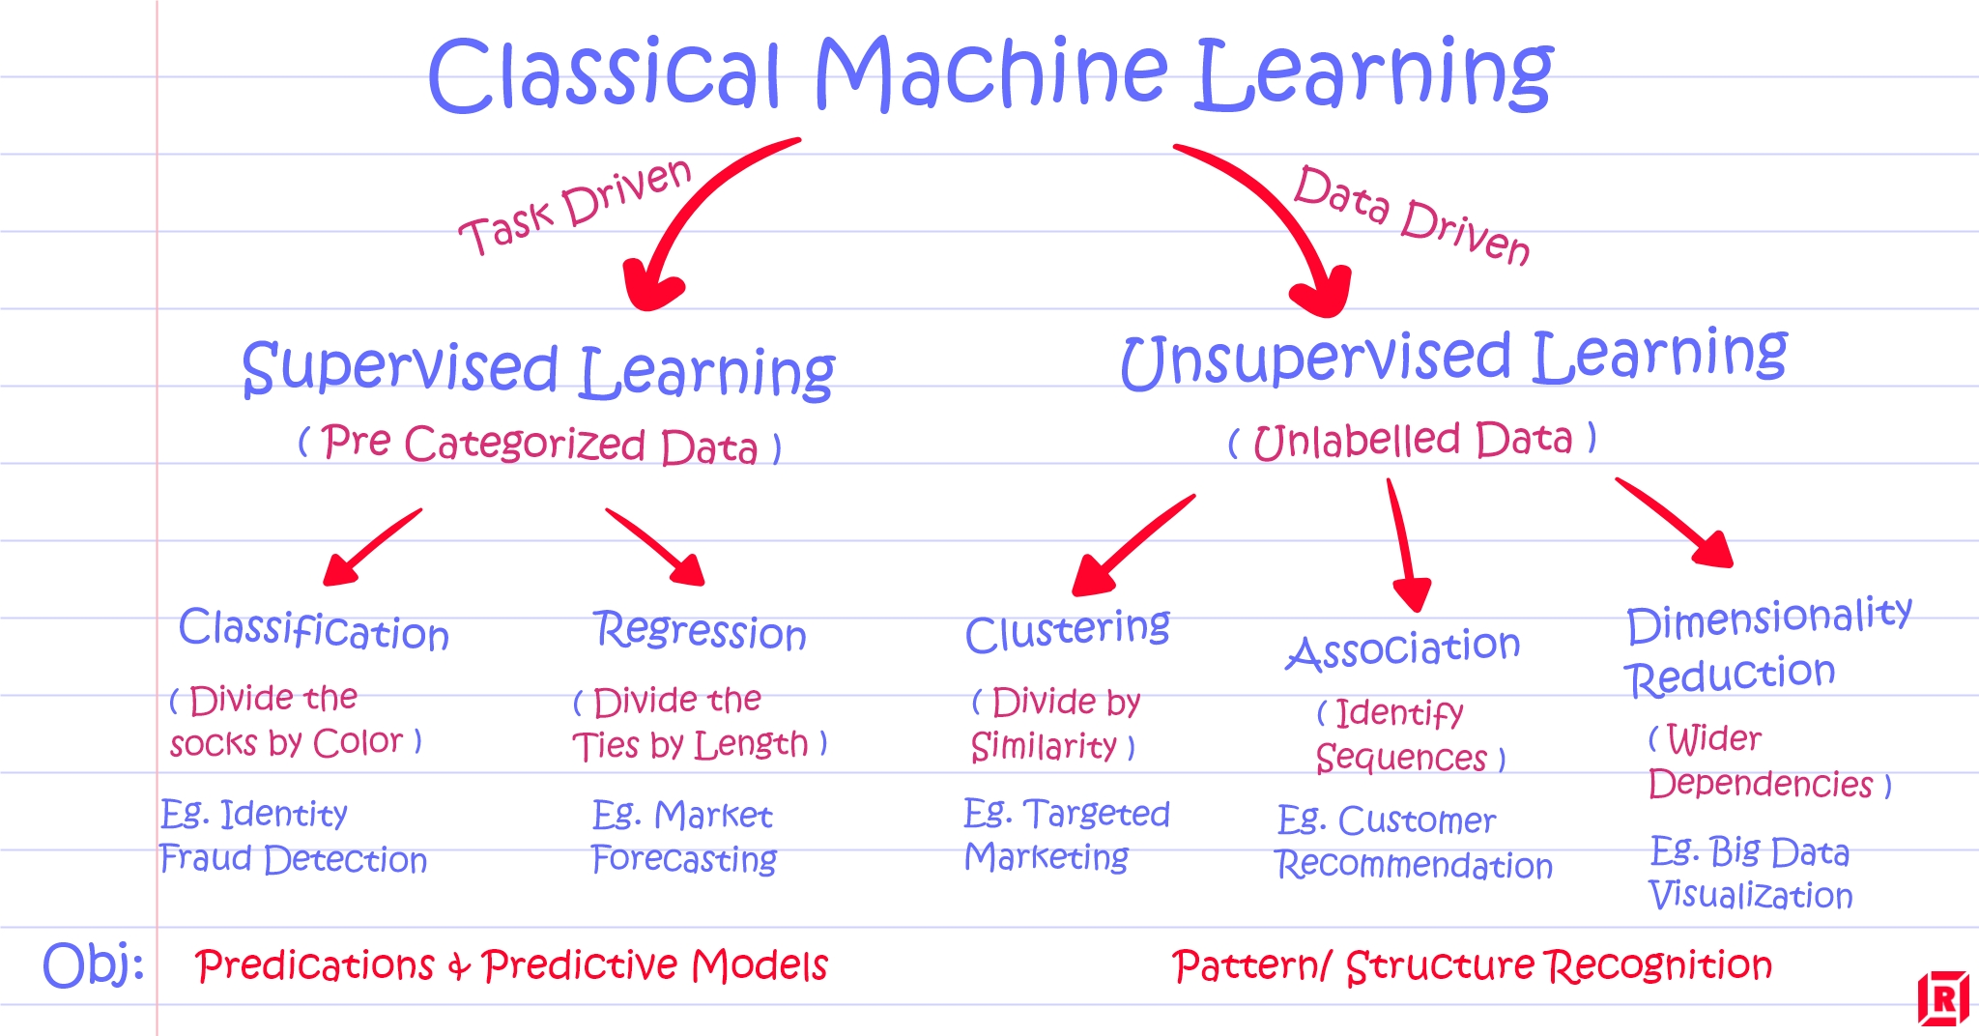

Slide 15

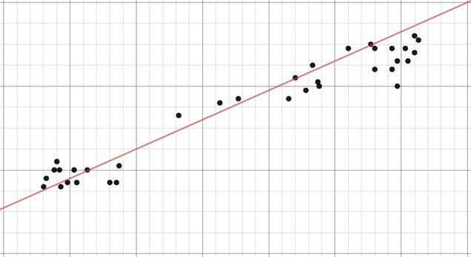
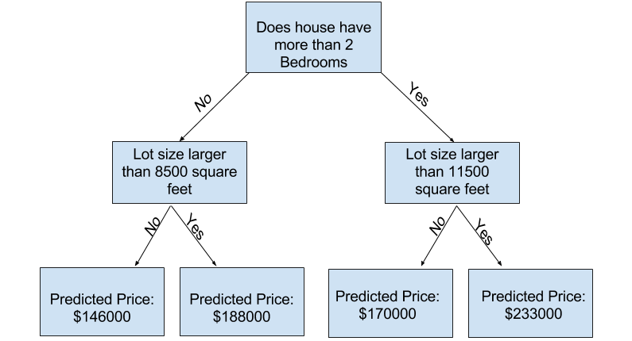
Regression
In regression models, the output is continuous. Below are some of the most common types of regression models.
LINEAR REGRESSION
DECISION TREE

Slide 16
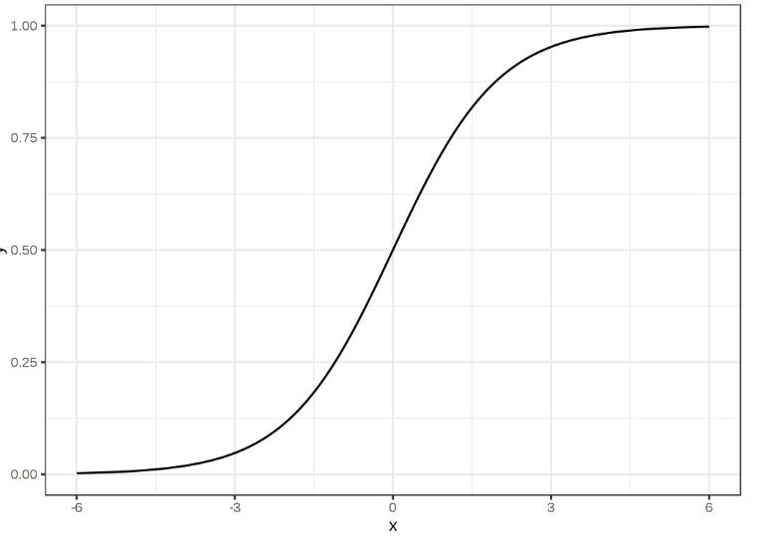

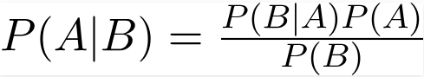
Classification
In classification models, the output is discrete. Below are some of the most common types of classification models.
LOGISTIC REGRESSION
SUPPORT VECTOR MACHINE
NAIVE BAYES

Slide 17
EXPLANATION
Unsupervised
Unsupervised statistical learning, there are inputsbut no supervising output; but we can learn relationships andstructure from such data.
Clustering
Dimensionality Reduction

Slide 18

Clustering
Clustering is an unsupervised technique that involves the grouping, or clustering, of data points. It’s frequently used for customer segmentation, fraud detection, and document classification.
Method/ Algorithm ex.:
K-MEANS CLUSTERING

Slide 19
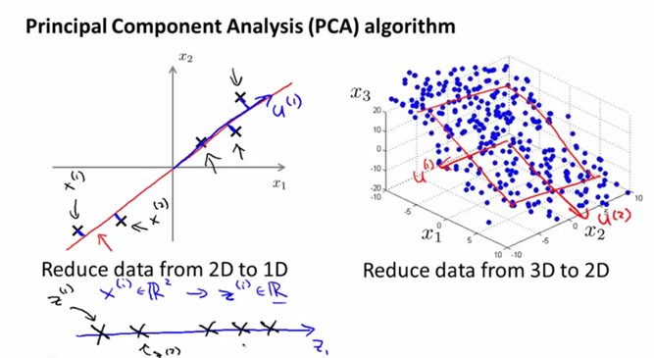
Dimensionality Reduction
Dimensionality reduction is the process of reducing the number of random
variables under consideration by obtaining a set of principal variables
Most dimensionality reduction techniques can be categorized as either feature elimination or feature extraction.
Method :

Slide 20
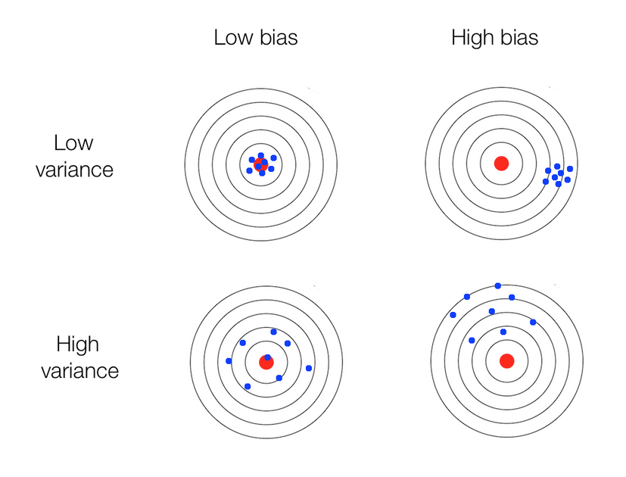

Bias and Variance
Bias is the model’s tendency to consistently learn the wrong thing by not taking into account all the information in the data.
Variance is the model’s tendency to acquire random things irrespective of the real signal.
The relationship between bias and variance in statistical learning issuch that:•
Increasing bias will decrease variance.•
Increasing variance will decrease bias.

Slide 21
References
https://luminousmen.com/post/descriptive-and-inferential-statistics
https://towardsdatascience.com/data-science-simplified-key-concepts-of-statistical-learning-45648049709e
Stuart J. Russell, Peter Norvig, Artificial Intelligence: A Modern Approach (2010), Prentice Hal
http://scott.fortmann-roe.com/docs/BiasVariance.html
https://towardsdatascience.com/all-machine-learning-models-explained-in-6-minutes-9fe30ff6776a
https://www.wikihow.com/Calculate-Probability

Slide 22
Thank You

